Slide 1

Get it Done San Diego – Dashboard
Team: Git It On
UCSD Data Science and Visualization Bootcamp | Project 2

Slide 2
Team Git It On
Melissa Monroe | Architecture, design, Heroku deployment, data, art
Andrew Bankston | Data, content, analysis, plots, maps
Jacob Zacarias | Data, content, analysis, plots, maps
Annette Broeren | Powerpoint, ReadMe

Slide 3
Task
Provide a dynamic dashboard for City of San Diego leadership to gage
Effectiveness of Get-It-Done program overall
Effectiveness of program by Council district
Performance indicators
Ticket volume by period, type, council district
Average response time from open to closed
Open/closed deltas
Ticket volumes by type by council district
Tool to assist in determining if certain districts require additional resources due to certain times of year that tickets spike or dip, if the volume of certain ticket types are increasing or decreasing by area, possibly indicating other issues such as gentrification, tourist season, etc.
Cause and effect may require additional analysis outside the scope of this database.

Slide 4
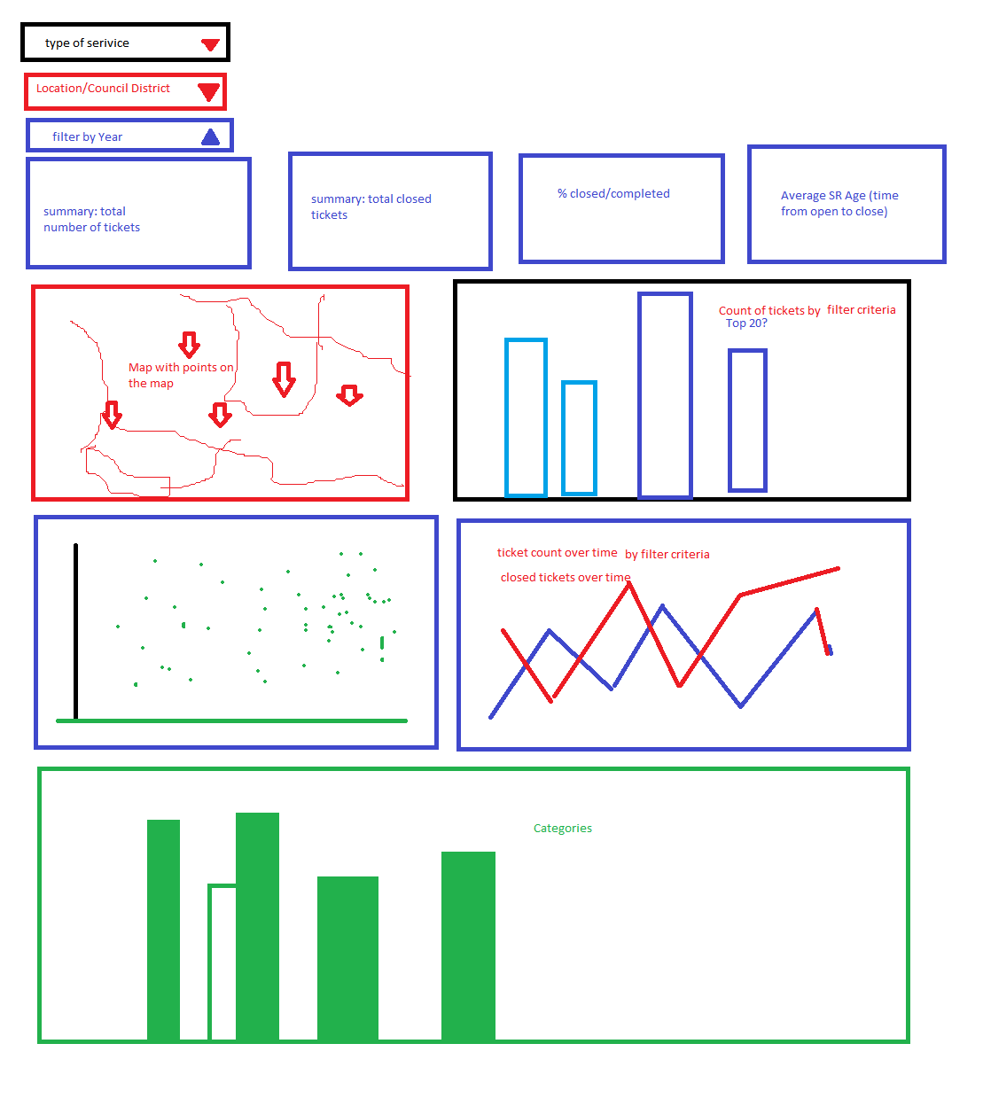
Concept
Freehand art by MM

Slide 5
Source data
City of San Diego Get It Done program files: https://data.sandiego.gov/datasets/get-it-done-311/
Get It Done Requests JSON API – json
Get It Done Requests year-to-date – csv
Get It Done Requests 2020 – csv
Get It Done Requests 2019 – csv
Get It Done Requests 2018 – csv
Get It Done Requests 2017 – csv
Get It Done Requests 2016 – csv
City Council Districts geoJson: https://data.sandiego.gov/datasets/city-council-districts/

Slide 6
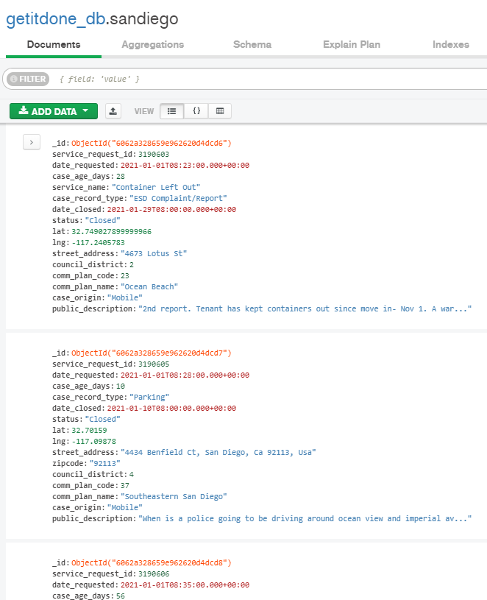
Behind the scenes
~700,000 documents
MongoDB
MongoDB charts
AJAX
Flask
Python
Jupyter Notebooks
Javascript
D3
Plotly
Leaflet
HTML
Heroku

Slide 7









Process
Data collecting
Processing
Routes
Visualization
Deployment

Slide 8
Dependencies
Flask – Routes
import os from flask import (Flask, render_template, jsonify, request, redirect) import pymongo from src import config from bson.json_util import dumps import json import requests import dns import datetime from datetime import datetime import pytz from django.utils import timezone from time import sleep import random import operator
Jupiter Notebook – Data gathering
import requests import pymongo import dns import datetime from datetime import datetime from dateutil import parser import pytz from django.utils import timezone from time import sleep import random import json import config import requests # Project defined dependencies import config from pprint import pprint
Jupiter Notebook – Visualizations
from matplotlib import pyplot as plt import numpy as np import scipy.stats as stats import pandas as pd # Project defined modules import config import visualization as viz
Python – Class Visualizer
import pymongo import dns import datetime from time import sleep import random import json import pandas as pd import numpy as np from matplotlib import pyplot as plt import config

Slide 9
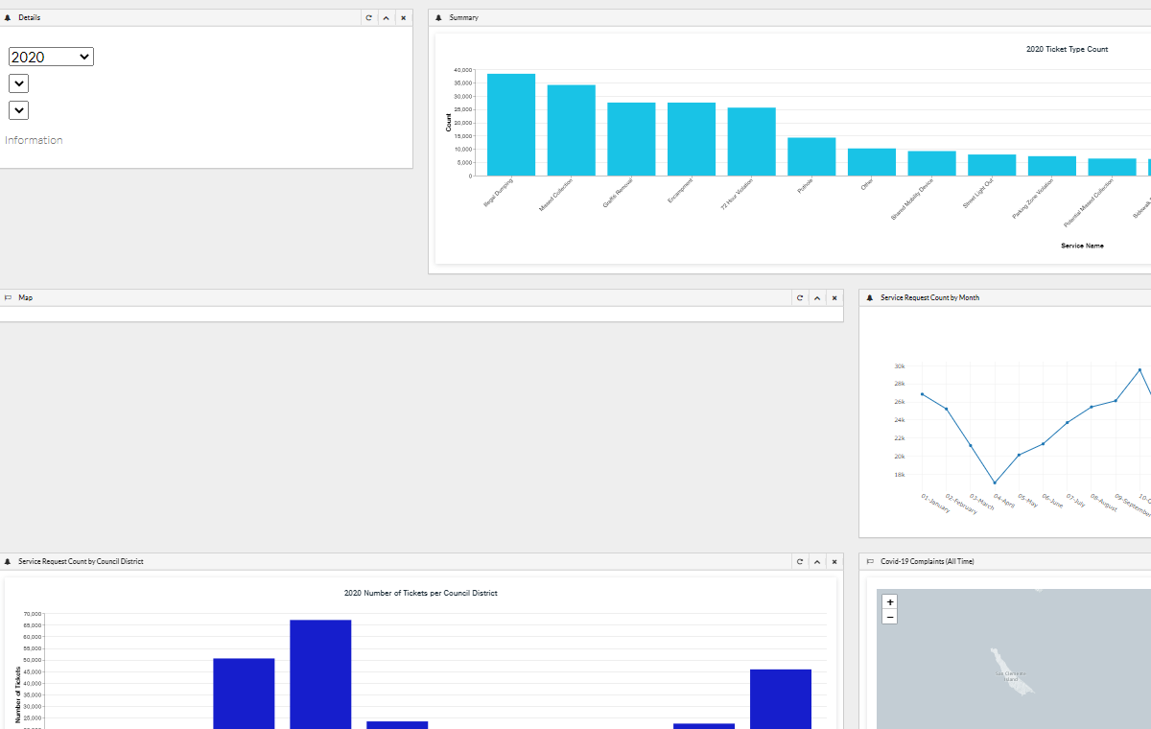
Niceadmin Dashboard Template: Development

Slide 10
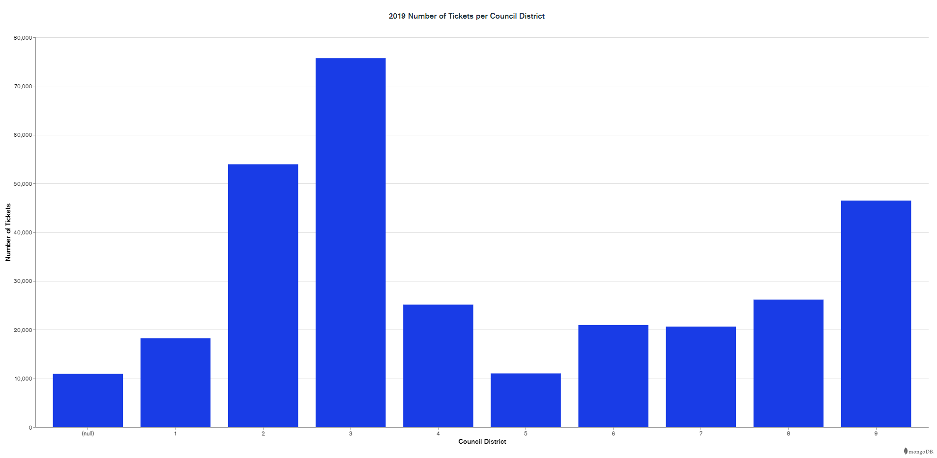
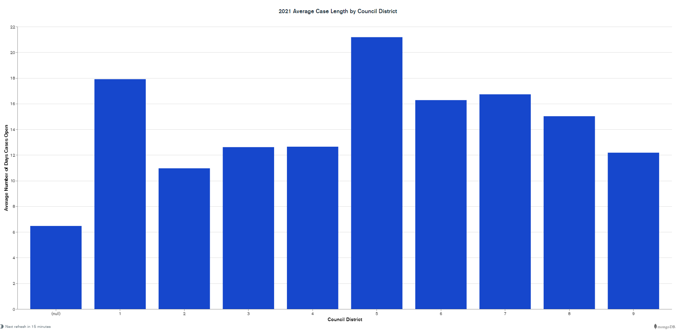
Dashboard Functions for San Diego Get It Done Database
Year selector
Total tickets by year
Tickets by council district
Top 20 Tickets by type
Service ticket counts by council district
Case length by council district

Slide 11
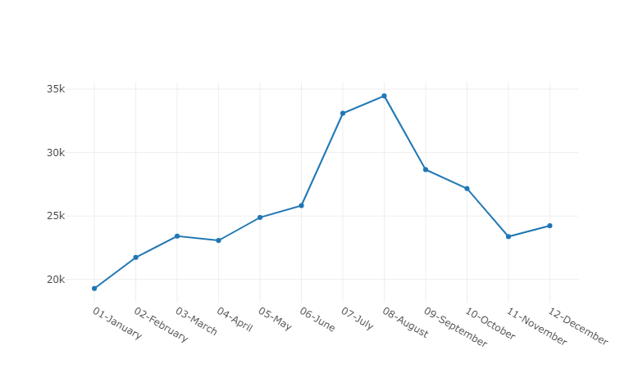
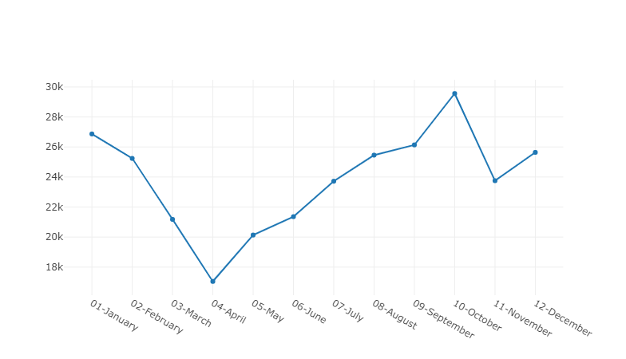
No. of tickets by year – Plotly
In 2020, tickets dipped significantly in April which correlates with the start of COVID-19 restrictions, and peeked in October.
In 2019, tickets peeked in July and August.
2019 Get It Done Tickets
2020 Get It Done Tickets

Slide 12
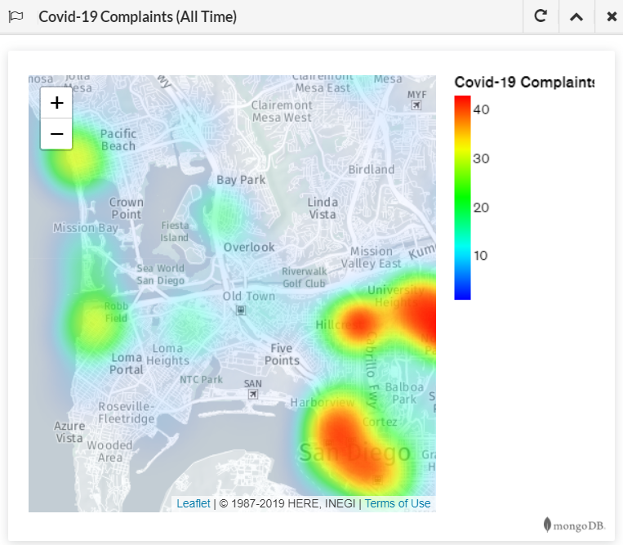
COVID-19 Heat Map
MongoDB Charts

Slide 13
Opportunities to add value
Metrics
Volume of tickets by category by year / quarter / area
Is volume of tickets evenly distributed by area?
Do certain areas have a noticeably smaller or larger number of tickets in any category?
Is the volume of tickets steady or are there dips/spikes?
Are dips or spikes occurring during certain times of the year? Certain districts?
Key performance indicators
Average days from open to close, group by category, group by location?
Is average time to resolve a ticket same across categories? Across districts?
Spikes/dips? Certain areas? Certain times of year?
Features
Leaflet mapbox with popup tool tip for service tickets in area
Scatter plots tickets vs council district

Slide 14
Appendix

Slide 15
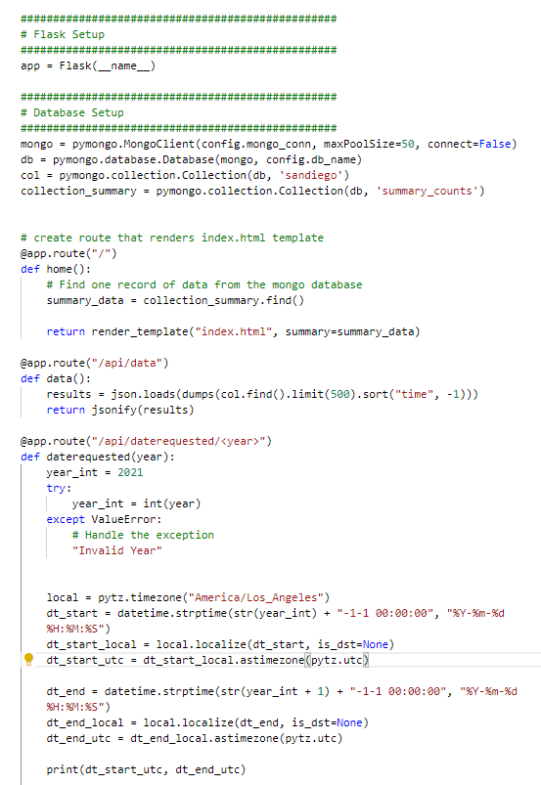
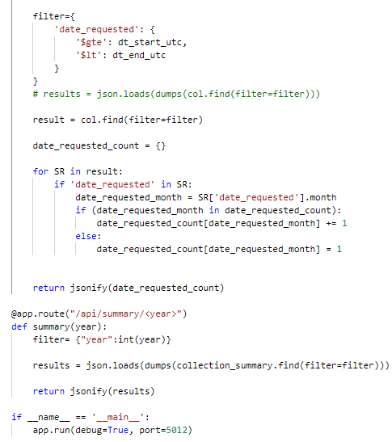
App.py
Flask

Slide 16
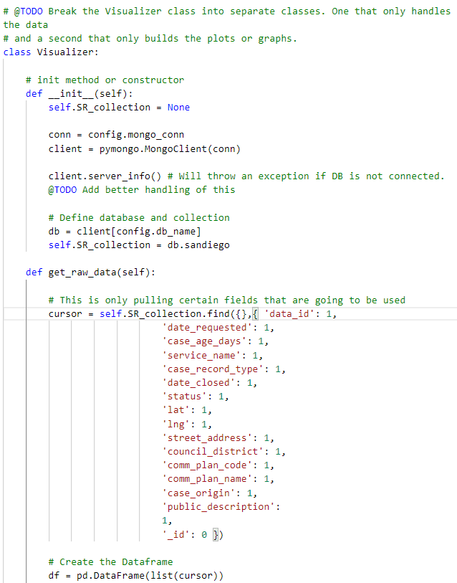
Visualization.py

Slide 17
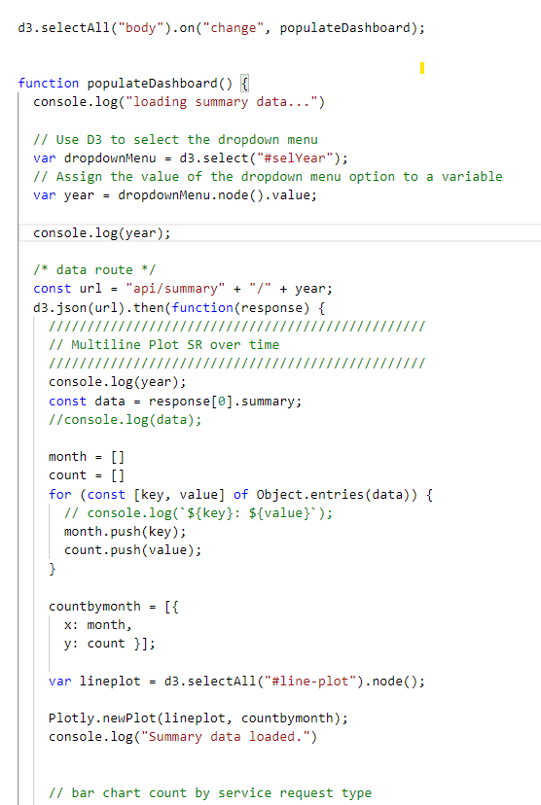
App.js
Populate dashboard

Slide 18
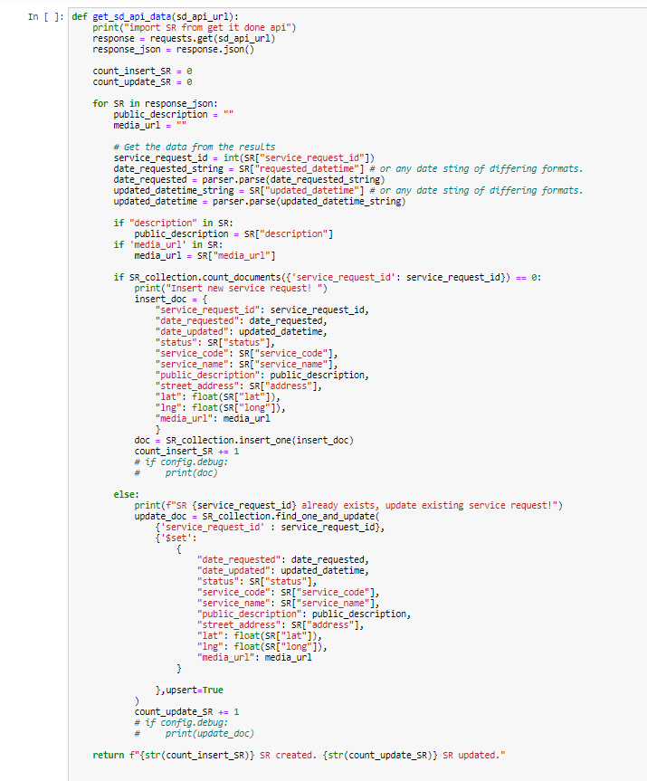
Main.ipynb
API Data

Slide 19
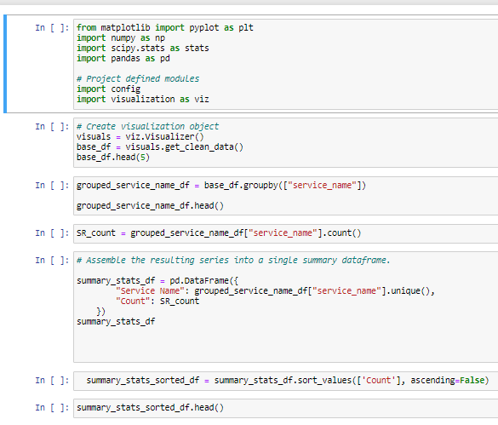
Visualization.ipynb

